Slide 1
MODULES and packages
Notes:
Welcome to a session on Modules and Packages

Slide 2

In this Module You will be able to
Identify modules and packages in Python
Work with various standard libraries
Prepare custom modules
Prepare packages and import modules from the packages
Notes:
After completing this module, you will be able to,
Identify modules and packages in Python,
Work with various standard libraries,
Prepare custom modules, and Prepare packages and import modules from the packages

Slide 3
Python Modules & Packages
A module is a file containing Python definitions (i.e. functions) and statements
The file name is the module name. The file will be saved with the extension “.py”
Packages are a way of structuring one or more modules together
Python Package Index is a repository of software for the Python
There are currently 118274 packages in this repository
To use a package from this index run:
"pip install <package_name>“ from command prompt
numpy : Used for array manipulations
os: Provides useful operating system dependent functionality
pandas: Used for data analysis and transformations
matplotlib: Used for plotting and visualization
Notes:
A module is a file containing functions and statements.
The file name is the module name.
The file will be saved with extension, .py.
Packages are a way of structuring one or more modules together.
There are many in-built modules or packages in python.
For example, Numpy is used for array manipulations.
OS, provides useful operating system dependent functionalities.
Pandas is used for data analysis and transformations.
Matplotlib is used for plotting and visualization of analyzed data.
Python package Index is a repository of software for Python.
There are currently 1 lakh 18 thousand 274 packages in this repository.
To use a package from this index, run "pip install space package name" from the command prompt.

Slide 4
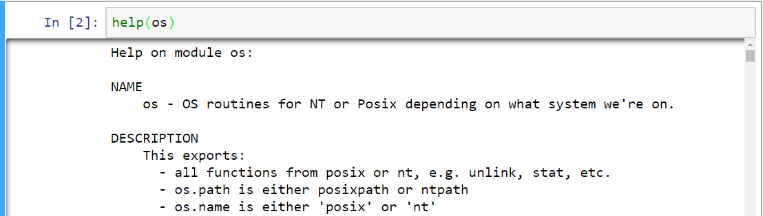
Importing Modules
Modules or packages can be imported into our program using “import” keyword, followed by the module’s name
Use help functions to know the description and available routines (or functions) within the imported module
Notes:
“import” keyword followed by the module’s name can be use to import modules or packages, in our program. Help functions can be used to know the description and the available routines (or functions) within the imported modules.

Slide 5
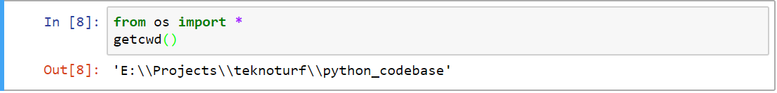
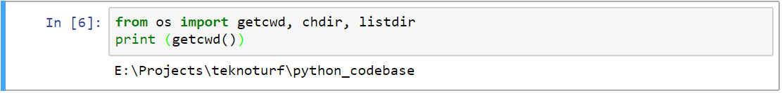
Different Ways in Importing Modules
Note that it is possible to call those functions directly without using the module name and dot operator.
One can also import all the functions and use them directly using “*” operator while importing
By default, all the routines will be available when we import a module.
It also import only those routines which we will be using.
For example in the below snippet we are importing only three functions/routines from the ’os’ module.
Note: Importing all the definitions using * operator is not recommended
Notes:
All the functions from a module can be imported at once using the “*” operator.
It is also possible to import only those routines which we will be using.
In the second snippet , we are importing only the three functions or routines that we require from os module.
It is also possible to import all the functions directly without using the module name and dot operator.

Slide 6
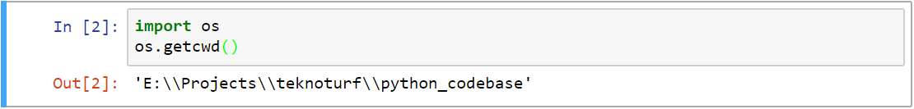
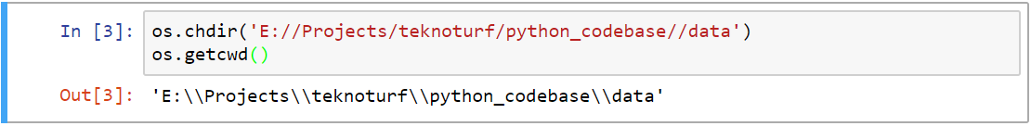
Standard Libraries – ‘os’ Module
Use dot operator to call a routine within a module.
For example use “os.getcwd()”, to know the current working directory
Change working directory
Get all files under the current working directory
Notes:
There are many operating system oriented operations that can be performed using Python’s ‘os’ module. Use dot operator to call a routine within a module.
“os dot get cwd” tells about the current working directory.
“os dot ch dir” changes the current working directory.
“os dot list dir” gets you all the files under the current working directory.

Slide 7


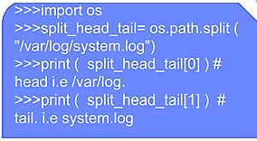
‘os’ Module
Returns "True" or "False" depending if it is a file or not
Returns "True" or "False" depending if it is directory or not
os.path.getsize(path) - Returns the size in bytes of path. Raises an OSError if the file does not exist or is inaccessible.
Notes:
To check the specified name is a file or not, use the method ‘os.path.file()’. It will return “True" or "False" depending on whether it is a file or not.
Like wise to check for a directory, the method ‘os.path.dir()’ helps.
To split the directory path and the file name into two different parts, we should use the method ‘os.path.split()’.
The method ‘os.path.getsize(path) ‘ returns the size in bytes of the path.

Slide 8
‘sys’ Module
sys.argv - This tells the arguments passed to the program
printpath.py
sys.exit() : The most often used command by the Python command interpreter to get out of the Python command prompt and back to the OS console ( or terminal)
import sys
print ( len( sys.argv))
for item in sys.argv:
print(item)
sys.float_info : This is a structure and contains the internal max and min value representation of the float data type
Execution:
$ python3 printpath.py one two three
sys.version : It displays the version of the Python interpreter currently being used.
Notes:
sys.argv This tells the arguments passed to the program. argv[0] is the name of the program itself. argv[2] ( if any ) is the following argument and so on.
then get that by len(sys.argv) - this lists the length of the number of arguments passed to the program.
Use quit() or Ctrl-D (i.e. EOF) or exit()to exit from the Python console. This can be used inside the Python code as well, to return a specific return code from the program.
sys.float_info : This is a structure and contains the internal max and min value representation of the float data type.
sys.version displays the version of the Python interpreter currently using.

Slide 9
‘datetime’ Module
Functions are available for this module to print the current date and time.
User has to import date library to start using the different functions
To get the epoch time use, time.gmtime(0) function.
The datetime module has functions and classes to parsing date and time functions :
print (dir(datetime)) will print all the members of the datetime.
print (dir(datetime.datetime)) will print the list of methods within this class.
‘now()’, prints the current local date and time. Same as ‘today()’
The method utcnow() prints the UTC date and time
time.strptime() is a string parser, this will convert a string format to datetime.
Datetime.strftime() is a string formatter. This will format a datetime object to string format.
from datetime import datetime
now = datetime.now() # current date and time
date_time = now.strftime("%m/%d/%Y, %H:%M:%S")
print("date and time:",date_time)
from datetime import datetime
timestamp = 1528797322
date_time = datetime.fromtimestamp(timestamp)
Dt_str = date_time.strftime("%m/%d/%Y, %H:%M:%S")
Notes:
The’datetime’ module contains all functionalities related to date and time in Python.
The epoch is the point where the time starts, and is platform dependent. For Unix, the epoch is January 1, 1970, 00:00:00 (UTC).
To find out what the epoch is on a given platform, look at:
time.gmtime(0) where we have to import the time module.
print dir(datetime.datetime))- will print the list of methods within this class
datetime.strptime() is a string parser. It will convert a string format to datetime.
Datetime.strftime() is a string formatter. This will format a datetime object to string format.

Slide 10
‘math’ Module
import math
math.floor(x) - floors the value of x to the lower integer
e.g.: math.floor(1.99999) is 1.0, and is converted to float.
Whereas int(1.99) is 1 (Integer)
math.ceil( x) - raises the value to the nearest ceiling integer.
e.g.: math.ceil ( 1.0001) = 2.0
fabs() function returns the absolute value of the number.
factorial() :- This function returns the factorial of the number.
round( x, [n] ) - is another useful function to round the number to a certain precision.
e.g.: round ( 1.9991, 3 ) = 1.999 and round ( 1.9999, 3 ) = 2.0
Notes:
To use mathematical functions in a Python program, import the ‘math’ module.
Some of the methods are:
ceil() method returns the smallest integral value greater than the number.
floor() function returns the greatest integral value smaller than the number.
fabs() function returns the absolute value of the number.
factorial() :- This function returns the factorial of the number.
Round() method to round off the given number.

Slide 11
‘shutil’ Module
This module has a number of functions to support the copying and removal of files.
In order to use the module, the user would have to import the module shutil. As:
“ import shutil “
Sample methods:
import shutil
shutil.copy(src, dst, *, follow_symlinks=True)
This function copies the source file to the destination
The source and the destination arguments have to be strings
shutil.move(src, dst, copy_function=copy2)
Recursively move a file or directory (src) to another location (dst) and return the destination.
Notes:
The shutil module contains functions for operating on files.
We might have noticed that os module also contains a function for renaming or moving files, (os.rename). Generally, we hould use shutil.move instead, because it is more robust/complete than os.rename.

Slide 12
‘filecmp’ Module
This module helps in comparing files in directories or different directories
Some of the functions are:
filecmp.cmp(f1, f2, shallow=True) :
This allows us to compare the files f1 and f2, Returns True if they are equal, Return False otherwise
filecmp.cmpfiles(directory1, directory2, commonname, shallow=True) :
This function compares the files in the two directories directory1 and directory2 whose names are given by common. It returns three lists of files: match,mismatch, error file
filecmp.clear_cache():
Clear the filecmp cache. This may be useful if a file is compared so quickly after it is modified that it is within the time resolution of the underlying file system.
Notes:
The filecmp module defines the following functions:
filecmp.cmp(f1, f2, shallow=True), compare the files named f1 and f2, returning True if they seem equal, False otherwise. If shallow is true, files with identical os.stat() signatures are taken to be equal. Otherwise, the contents of the files are compared.
Note that no external programs are called from this function, giving it portability and efficiency. This function uses a cache for past comparisons and the results, with cache entries invalidated if the os.stat() information for the file changes. The entire cache may be cleared using clear_cache().
filecmp.cmpfiles(dir1, dir2, common, shallow=True) method compare the files in the two directories dir1 and dir2 whose names are given by common. Returns three lists of file names: match, mismatch, errors.
Match contains the list of files that match, mismatch contains the names of those that don’t, and errors lists the names of files that could not be compared. Files are listed in errors if they don’t exist in one of the directories, the user lacks permission to read them or if the comparison could not be done for some other reason.
The shallow parameter has the same meaning and default value as for filecmp.cmp().
For example, cmpfiles('a', 'b', ['c', 'd/e']) will compare a/c with b/c and a/d/e with b/d/e. 'c‘ and 'd/e' will each be in one of the three returned lists.

Slide 13
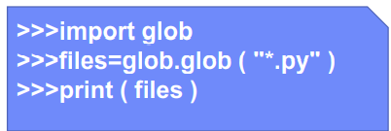
‘glob’ Module
• This module finds all the files, matching a pattern as set by Unix rules.
This takes another argument called “recursive = True”.
If this is specified ,then the search happens for all the folders within the directory
Notes:
The glob module finds all the pathnames matching a specified pattern according to the rules used by the Unix shell, although results are returned in arbitrary order.
No tilde expansion is done, but *, ?, and character ranges expressed with [] will be correctly matched.
This is done by using the os.scandir() and fnmatch.fnmatch()functions in concert, and not by actually invoking a subshell.
Note that unlike fnmatch.fnmatch(), glob treats filenames beginning with a dot (.) as special cases. (For tilde and shell variable expansion, use os.path.expanduser() and os.path.expandvars().)

Slide 14
‘pickle’ Module
Pickling (serialization/marshalling/flattening) is a way to convert a Python object (list, dictionary, etc.) into a byte stream before writing to a file or database and this stream contains all the information necessary to reconstruct the object.
The reverse process is known as unpickling in which a byte stream (from a binary file or bytes-like object) is converted back into a Python object structure.
Two major functions in this module are:
1. pickle.dump(obj, file, protocol=None, *, fix_imports=True, buffer_callback=None): It writes the pickled representation of the object to the file object file.
2. pickle.load(file, *, fix_imports=True, encoding='ASCII', errors='strict', buffers=None) : It reads the pickled representation of an object from the file object file and return the reconstituted object.
Notes:
Python pickle module is used for serializing and de-serializing a Python object structure.
Any object in Python can be pickled so that it can be saved on a disk. What pickle does is that it “serializes” the object first before writing it to file. Pickling is a way to convert a Python object (list, dictionary, etc.) into a character stream. The idea is that this character stream contains all the information necessary to reconstruct the object in another python script.
Pickle module is used for serializing (pickling) and de-serializing (un-pickling) a Python object structure
Python objects can be pickled before writing them to a file.
“Unpickling” is the inverse operation, in which a byte stream (from a binary file or bytes-like object) is converted back into a Python object structure.
Pickling is alternatively known as “serialization”, “marshalling,” or “flattening” like wise unpickling is known as non-serialization, unmarshalling, etc.
Two major functions in this module are:
dump() and load():
pickle.dump() method writes the pickled representation of the object obj to the open file object file.
Pickle.load() method read the pickled representation of an object from the open file object file and return the reconstituted object hierarchy specified therein.

Slide 15
‘pickle’ Module - Example
import pickle
# Creating the pickled object and storing into a file
employee1 = {'key' : 'Emp101', 'name' : 'Jane', 'salary' : 50000}
employee2 = {'key' : 'Emp102', 'name' : 'Harry',‘salary' : 75000}
employee = {}
employee['employee1'] = employee1
employee['employee2'] = employee2
file = open('employee_data', 'ab')
pickle.dump(employee, file)
file.close()
#Converting the pickled object to unpickled object and displaying the content
file = open('employee_data', 'rb')
employee = pickle.load(file)
for keys in employee:
print(keys, '=>', employee[keys])
file.close()
Notes:
The given sample program depicts how to perform pickling and unpickling of a dictionary object. Observe the program.

Slide 16
Dumps() and loads()
Pickling and unpickling without using file:
dumps() – In this, instead of writing it to a file, it returns the pickled representation of the object as a bytes object.
Syntax: pickle.dumps(obj, protocol=None, *, fix_imports=True, buffer_callback=None)
loads() - It returns the reconstituted Python object o the pickled representation data of an object.
Syntax: pickle.loads(data, /, *, fix_imports=True, encoding="ASCII", errors="strict", buffers=None)
#For pickling
pickle_obj= pickle.dumps(employee)
# For loading
employee_info = pickle.loads(pickle_obj)
print(employee_info)
Notes:
For performing pickling and unpickling without using a file, dumps() and loads() methods are used.
dumps() – In this, instead of writing it to a file, it returns the pickled representation of the object as a bytes object.
loads() - It returns the reconstituted Python object o the pickled representation data of an object.
In dumps() method; the buffer_callback argument is added whereas in the loads() method data must be a bytes-like object.
Observe the syntax and the code snippets are given.

Slide 17
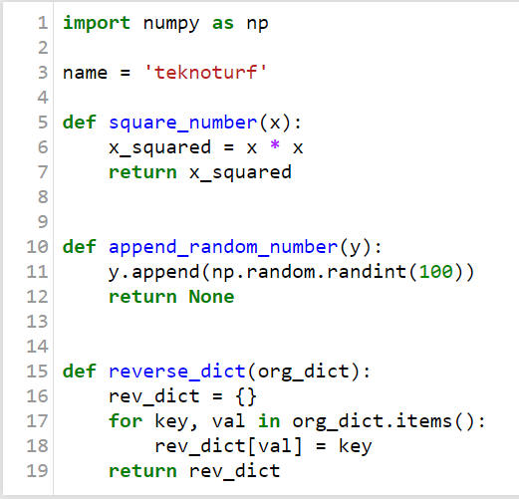
Creating Custom Modules
It is possible to create custom functions and variables based on various requirements.
It is easy to store them as modules by saving them inside a file . The file should have extension .py
Definitions from the modules are easy to import, just like importing in-built modules in a program
There are a few restrictions while naming the file. Do not have spaces, hyphen, etc. within the file name
For example the definitions shown on the right side are stored in a file with name utils.py
Notes:
We will be often creating custom functions and variables based on our requirements to use them at any point in time.
It is easy to store them as modules, by saving them inside a file with .py extension.
Do not include spaces, hyphens, etc. while naming the file.
Definitions from such modules are easy to import, just like we import inbuilt modules.

Slide 18
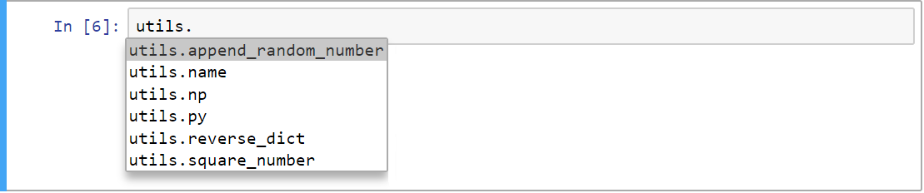
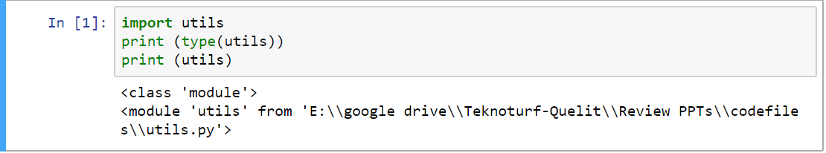
Custom Modules
The function square_number() under utils module can be called as shown. Use dot operator to separate the module and function.
All the definitions inside the module can be viewed by typing the module name, following by dot operator and then by pressing the tab key.
Notes:
Custom modules can be imported just like normal modules.
All the definitions inside the module can be viewed by typing the module name followed by the dot operator and then by pressing the tab key.

Slide 19
Calling Module Definitions
Just like function, the variables used inside the module can be used while importing the module. These variables are called attributes.
Just like any other standard module, the custom module can also be imported.
Notes:
We have to use the dot operator to separate the module and function in the module. Not just functions, even the variables inside the module can be used on importing the module. These variables are called attributes.

Slide 20
Creating Packages
Packages are nothing but a collection of one or more modules in a single folder
Instead of import every module individually, it is possible to import a package and access all the modules and their definitions
test.ipynb
custom/
__init__.py
utils.py
utils2.py
To import the ‘utils’ module from ‘test.ipynb’ notebook
We can create a folder called custom , which will also be the package name
The package folder should have ‘__init__.py’ and ‘utils.py ‘as shown here.
Note:
In earlier versions, (before Python 3.5) while placing modules inside a folder, additionally, need to create an empty file with the name “__init__.py. In the latest versions, it is not required.
Notes:
Packages are a collection of one or more modules in a single folder.
Instead of importing every module individually, we can import a package and access all the modules and the definitions inside modules.
While placing modules (python files with extension .py) inside a folder, we need to create an empty file named “_ _init_ _ .py”. Note that it is double underscore before and after init keyword.
Only then the modules will get imported inside another Python file or code.

Slide 21
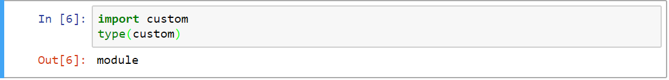
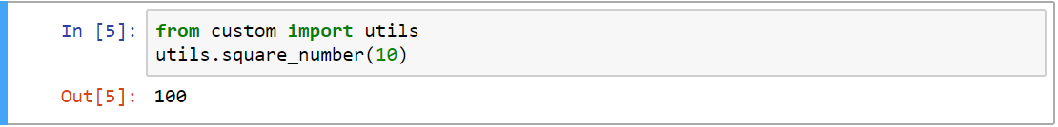
Import Modules From Packages
In the Python language, the type of the package will be module only.
The package is just a convenient name used by everyone to differentiate between the module and a folder with a collection of modules.
Instead of directly importing the module, import the module along with the package name separated by dot operator.
In the given example, first importing ‘utils’ module from the custom package, then calling an appropriate function that is defined in the module.
Notes:
We can import a module within the package, only by specifying the package name.
In the example, we are importing the ‘utils’ module from the custom package.
After importing, we can start using the definitions normally.
In Python, the type of the package is a module.
The package is just a convenient name used by everyone to differentiate between the module and a folder with a collection of modules.

Slide 22

In this Module You have learnt to
Identify modules and packages in Python
Work with various standard libraries
Prepare custom modules
Prepare packages and import modules from the packages
Notes:
Having completed this session you would have learnt to,
Identify modules and packages in Python,
Work with various standard libraries,
Prepare custom modules, and prepare packages and import modules from the packages.

Slide 23
THANK you
Notes:
Thank you!! Happy learning!!.

